Slide 1
“KINESICS”
Communication and Presentation Skills
Department of Computer Science
FAST NU Peshawar
Lecture by Ms. Maryam Ali Khan

Slide 2
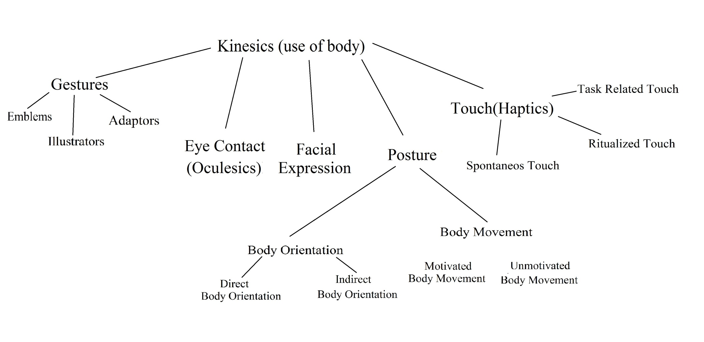
KINESICS

Slide 3
1. GESTURES
Emblems- substitute verbal message: finger on lips
Illustrators- aid verbal message: this tall, this round and that long
Adaptors- unconscious response to physical or psychological needs: itching or scratching etc
  Adaptors don’t mean to communicate anything but people add to it.

Slide 4
TASK
DID YOU KNOW?
Gestures vary from culture to culture.
Look for 3 gestures that have different meanings in different cultures

Slide 5
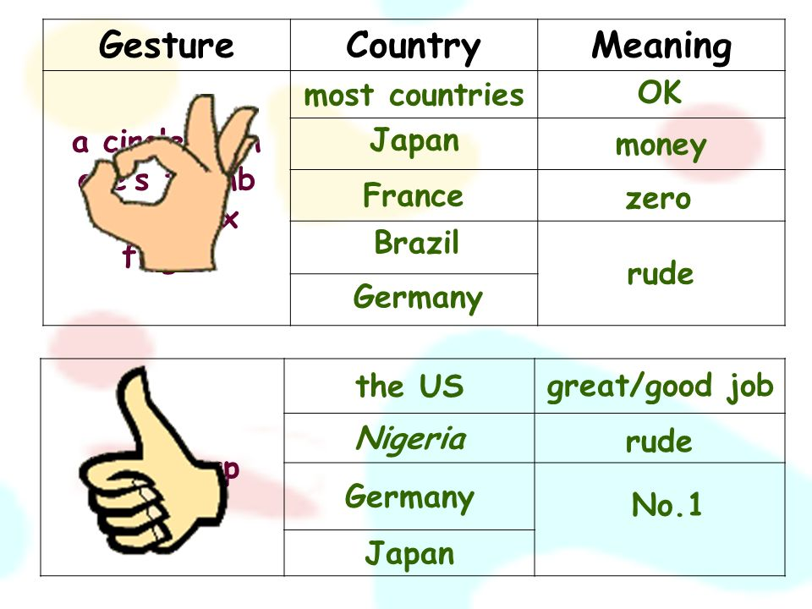

Slide 6
2. EYE CONTACT (OCULESICS)
How we look at others
How much we look at others
Eye contact may mean: respect, attentiveness and being rude
Eye contact is avoided while discussing something embarrassing
Anna shares Aleen’s secret with her class. Aleen stares at her for signaling her to stop sharing the secret.
Eye contact varies from culture to culture

Slide 7
3. FACIAL EXPRESSION
Arranging facial muscles to communicate something
Conveys six basic emotions:
  happiness
  Sadness
  Surprise
  Fear
  Anger
  Disgust
Varies from culture to culture

Slide 8
4. POSTURE
The position in which a person holds his body
Shows: attentiveness, respect or dominance
BODY ORIENTATION: position of our body in relation to others
  Direct Body Orientation: Face to Face
  Indirect body Orientation: Side by Side
Which body orientation is effective? It varies from situation to situation.
In a job interview:
  Direct Body Orientation: attentiveness and confidence
  Indirect Body Orientation: disrespect

Slide 9
Body Movement: changing body position
  Motivated Body Movement: movement that clarifies
  Unmotivated Body Movement: movement that distracts
While making a speech, Roger’s upright stance and squared shoulders communicate poise and confidence. Taking a few steps to the left or right may signal a transition from one main point to the next but constant movement here and there can distract the listners.

Slide 10
5. TOUCH (HAPTICS)
What and how a touch communicates
Pat, slap, pinch, nudge etc
Spontaneous Touch, Ritualized Touch and Task Related Touch
SPONTANEOUS TOUCH: automatic, subconscious like pat on the back to appreciate someone who has done something excellent.
RITUALISED TOUCH: scripted touch for example a handshake
TASK RELATED TOUCH: to perform a certain unemotional function like physical examination of a patient

Slide 11
Some cultures consider touch normal while others consider it inappropriate

Slide 12
TASK
Find examples of 3 non-contact oriented cultures and 3 contact oriented cultures.

